Slide 1
CSE 417T Introduction to Machine Learning
Lecture 13 Instructor: Chien-Ju (CJ) Ho

Slide 2
Logistics
Homework 1 Returned
Regrade requests till this Saturday
Please be concise and polite
Homework 3: Due Mar 5 (Sat)
Keep track of your own late-day usages
Exam 1: Mar 10 (Thursday)
Topics: LFD Chapters 1 to 5
Covid-permitting
Timed exam (75 min) during lecture time in the classroom
Closed-book exam with 2 letter-size cheat sheets allowed (4 pages in total)
No format limitations (it can be typed, written, or a combination)
Mar 8 (Tuesday) will be a review lecture

Slide 3
Recap

Slide 4
Decision Tree

Slide 5
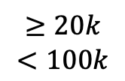
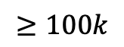
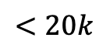
Decision Tree Hypothesis
Pros
Easy to interpret (interpretability is getting attention and is important in many domains)
Can handle multi-type data (Numerical, categorical. …)
Easy to implement (Bunch of if-else rules)
Cons
Generally speaking, bad generalization
VC dimension is infinity
High variance (small change of data leads to very different hypothesis)
Easily overfit
Why we care?
One of the classical model
Building block for other models (e.g., random forest)
Annual Income
$$≥100k$$
$$≥20k$$
$$<100k$$
$$<20k$$
Approve
have debt?
Deny
Deny
yes
no
Deny
Deny
Approve
Approve
Credit Card Approval Example

Slide 6
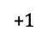
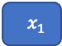
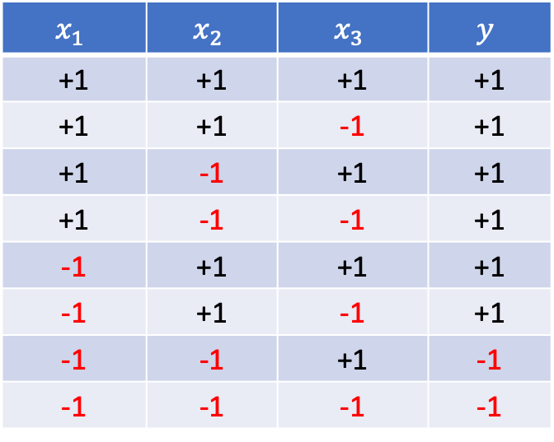
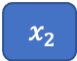
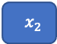
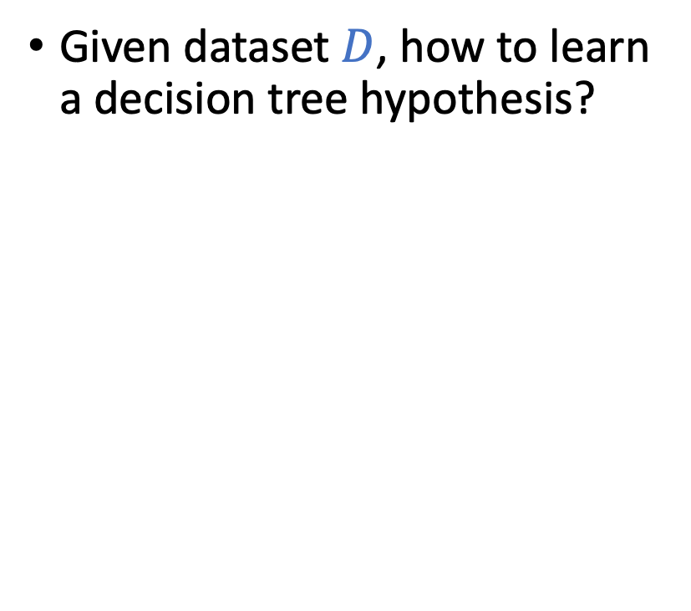
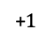
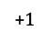
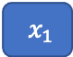
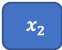
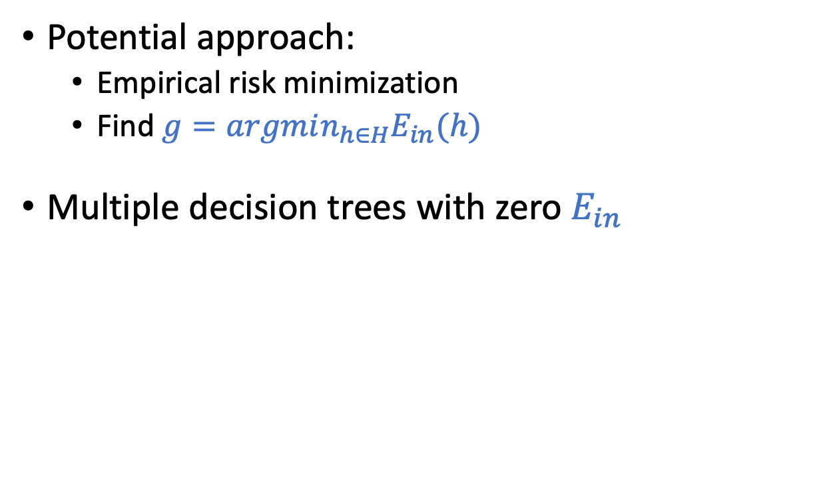
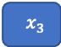
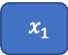
Learning Decision Tree from Data
Given dataset $D$, how to learn a decision tree hypothesis?
Potential approach:
Empirical risk minimization
Find $g=argmin_{h∈H}E_{in}(h)$
Multiple decision trees with zero $E_{in}$
$$x_{1}$$ | $$x_{2}$$ | $$x_{3}$$ | $$y$$
+1 | +1 | +1 | +1
+1 | +1 | -1 | +1
+1 | -1 | +1 | +1
+1 | -1 | -1 | +1
-1 | +1 | +1 | +1
-1 | +1 | -1 | +1
-1 | -1 | +1 | -1
-1 | -1 | -1 | -1
$$x_{3}$$
$$x_{1}$$
+1
-1
+1
-1
$$x_{2}$$
$$x_{2}$$
+$1$
$$x_{2}$$
+1
+1
-1
+1
-1
+1
-1
+$1$
$$x_{1}$$
+$1$
$$x_{1}$$
+1
+1
+$1$
-1
+1
-1
+1
-1
+1
-1
+1
+1
-1
+1
-1
+1
-1
How to avoid overfitting?

Slide 7
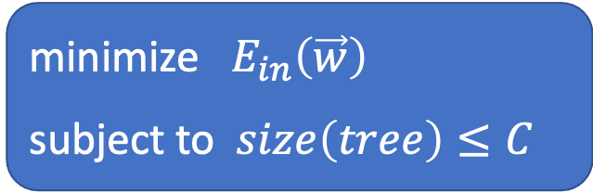
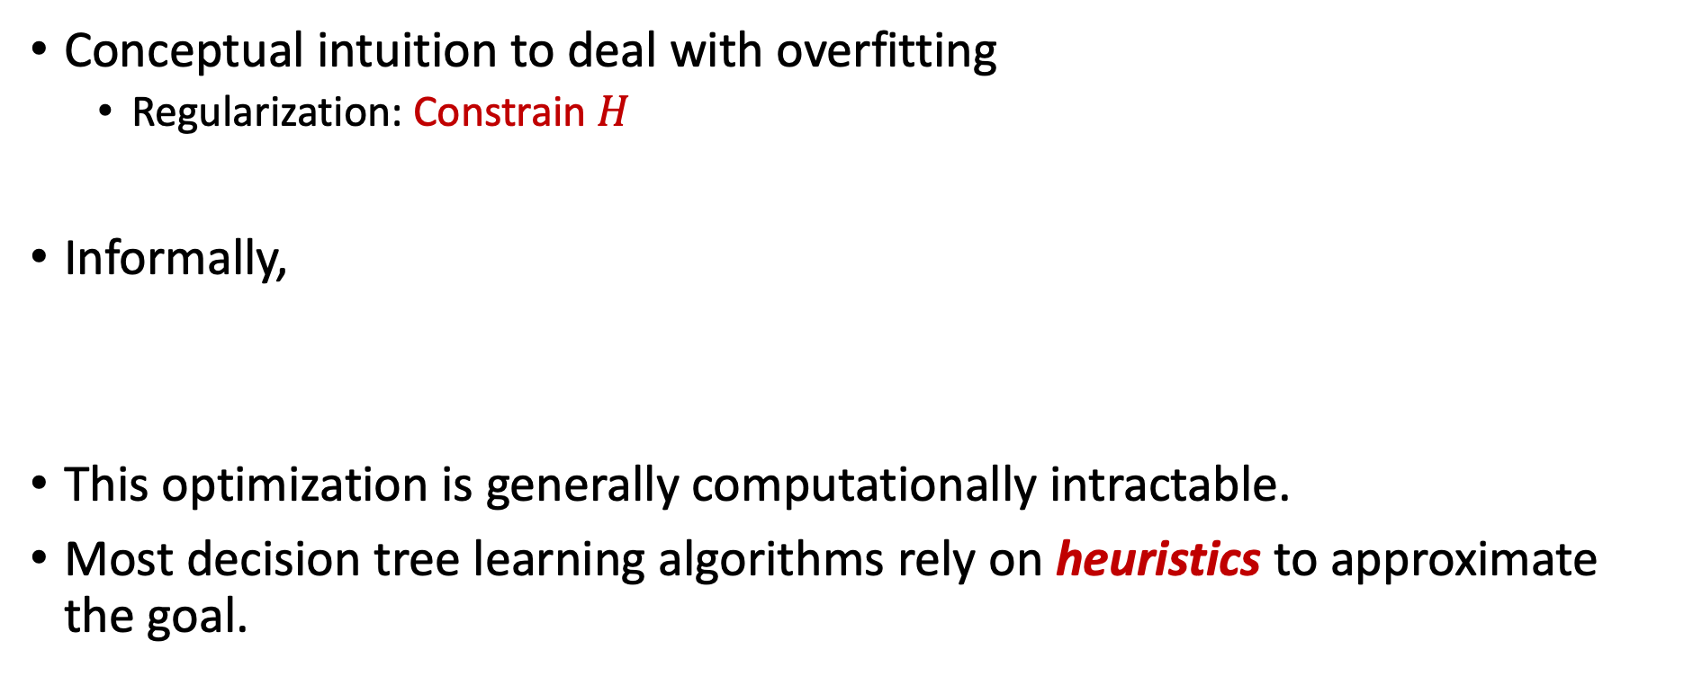
Learning Decision Tree from Data
Conceptual intuition to deal with overfitting
Regularization: Constrain $H$
Informally,
This optimization is generally computationally intractable.
Most decision tree learning algorithms rely on heuristics to approximate the goal.
minimize $E_{in}\left(\vec{w}\right)$
subject to $size\left(tree\right)≤C$

Slide 8
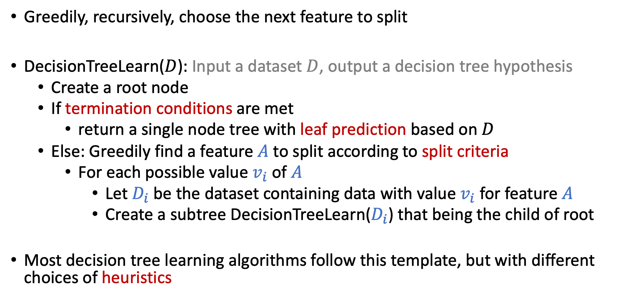
Greedy-Based Decision Tree Algorithm
Greedily, recursively, choose the next feature to split
DecisionTreeLearn($D$): Input a dataset $D$, output a decision tree hypothesis
Create a root node
If termination conditions are met
return a single node tree with leaf prediction based on $D$
Else: Greedily find a feature $A$ to split according to split criteria
For each possible value $v_{i}$ of $A$
Let $D_{i}$ be the dataset containing data with value $v_{i}$ for feature $A$
Create a subtree DecisionTreeLearn($D_{i}$) that being the child of root
Most decision tree learning algorithms follow this template, but with different choices of heuristics

Slide 9
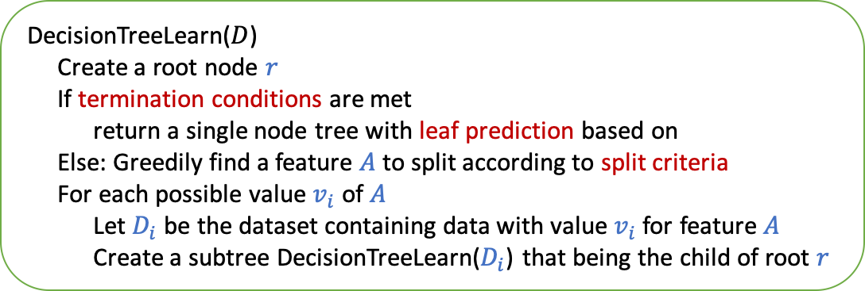
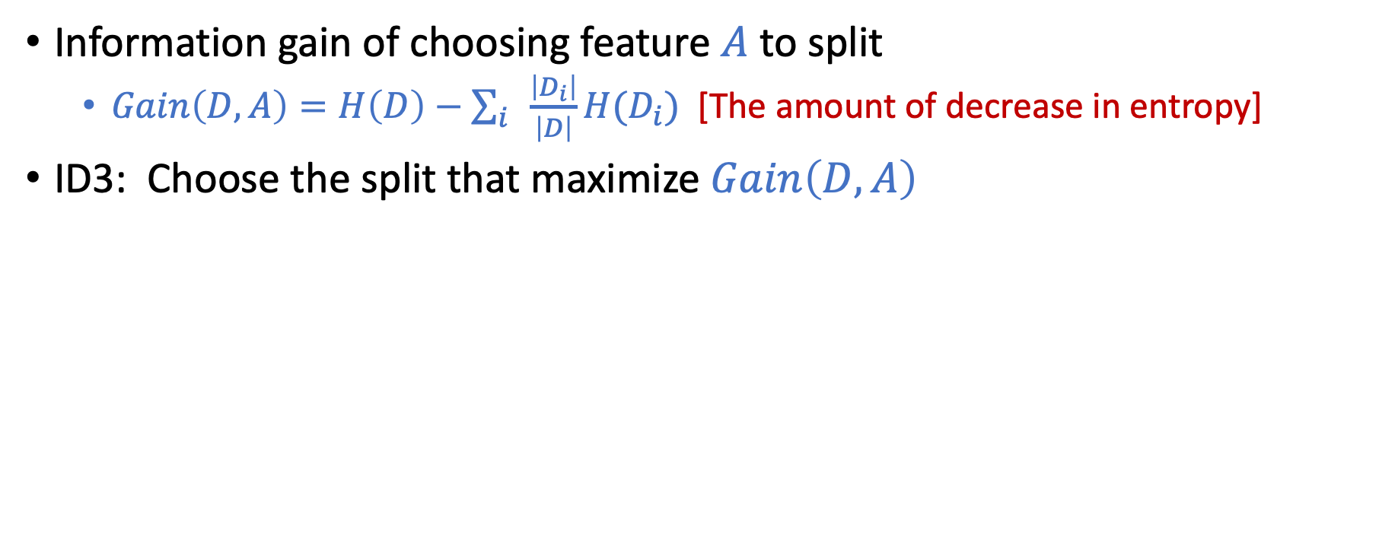
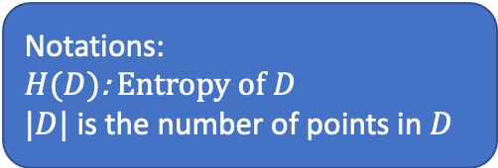
ID3: Using Information Gain as Selection Criteria
Information gain of choosing feature $A$ to split
$Gain\left(D,A\right)=H\left(D\right)−\sum_{i}{\frac{\left|D_{i}\right|}{\left|D\right|}}H(D_{i})$ [The amount of decrease in entropy]
ID3: Choose the split that maximize $Gain\left(D,A\right)$
Notations:
$H(D)$: Entropy of $D$
$|D|$ is the number of points in $D$
DecisionTreeLearn($D$)
Create a root node $r$
If termination conditions are met
return a single node tree with leaf prediction based on
Else: Greedily find a feature $A$ to split according to split criteria
For each possible value $v_{i}$ of $A$
Let $D_{i}$ be the dataset containing data with value $v_{i}$ for feature $A$
Create a subtree DecisionTreeLearn($D_{i}$) that being the child of root $r$
ID3 termination conditions
If all labels are the same
If all features are the same
If dataset is empty
ID3 leaf predictions
Most common labels (majority voting)
ID3 split criteria
Information gain

Slide 10
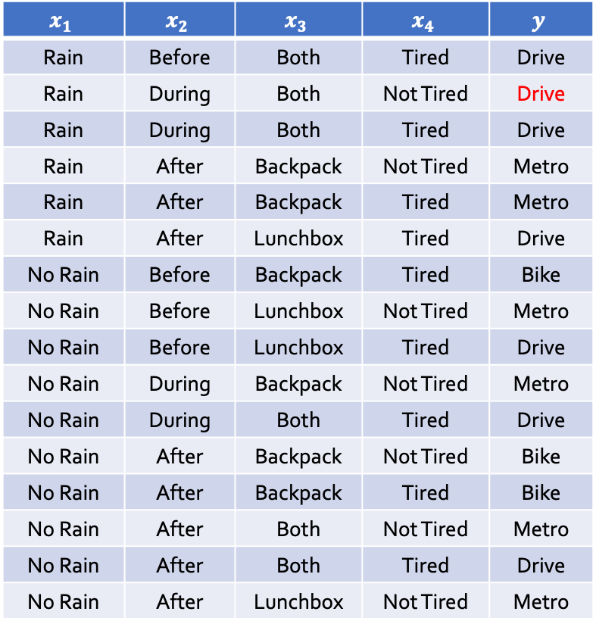
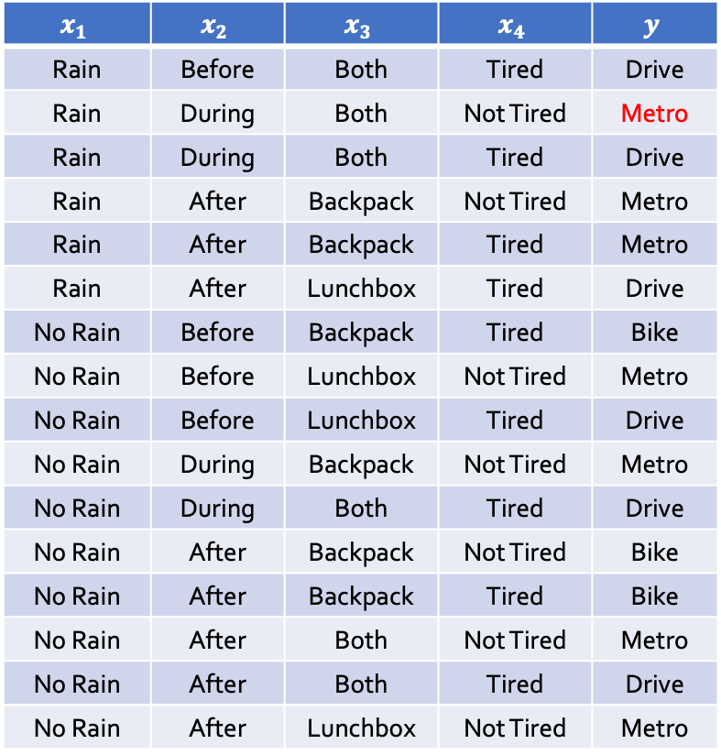
Illustration of ”High Variance” of Decision Trees
$$x_{1}$$ | $$x_{2}$$ | $$x_{3}$$ | $$x_{4}$$ | $$y$$
Rain | Before | Both | Tired | Drive
Rain | During | Both | Not Tired | Metro
Rain | During | Both | Tired | Drive
Rain | After | Backpack | Not Tired | Metro
Rain | After | Backpack | Tired | Metro
Rain | After | Lunchbox | Tired | Drive
No Rain | Before | Backpack | Tired | Bike
No Rain | Before | Lunchbox | Not Tired | Metro
No Rain | Before | Lunchbox | Tired | Drive
No Rain | During | Backpack | Not Tired | Metro
No Rain | During | Both | Tired | Drive
No Rain | After | Backpack | Not Tired | Bike
No Rain | After | Backpack | Tired | Bike
No Rain | After | Both | Not Tired | Metro
No Rain | After | Both | Tired | Drive
No Rain | After | Lunchbox | Not Tired | Metro
$$x_{1}$$ | $$x_{2}$$ | $$x_{3}$$ | $$x_{4}$$ | $$y$$
Rain | Before | Both | Tired | Drive
Rain | During | Both | Not Tired | Drive
Rain | During | Both | Tired | Drive
Rain | After | Backpack | Not Tired | Metro
Rain | After | Backpack | Tired | Metro
Rain | After | Lunchbox | Tired | Drive
No Rain | Before | Backpack | Tired | Bike
No Rain | Before | Lunchbox | Not Tired | Metro
No Rain | Before | Lunchbox | Tired | Drive
No Rain | During | Backpack | Not Tired | Metro
No Rain | During | Both | Tired | Drive
No Rain | After | Backpack | Not Tired | Bike
No Rain | After | Backpack | Tired | Bike
No Rain | After | Both | Not Tired | Metro
No Rain | After | Both | Tired | Drive
No Rain | After | Lunchbox | Not Tired | Metro

Slide 11
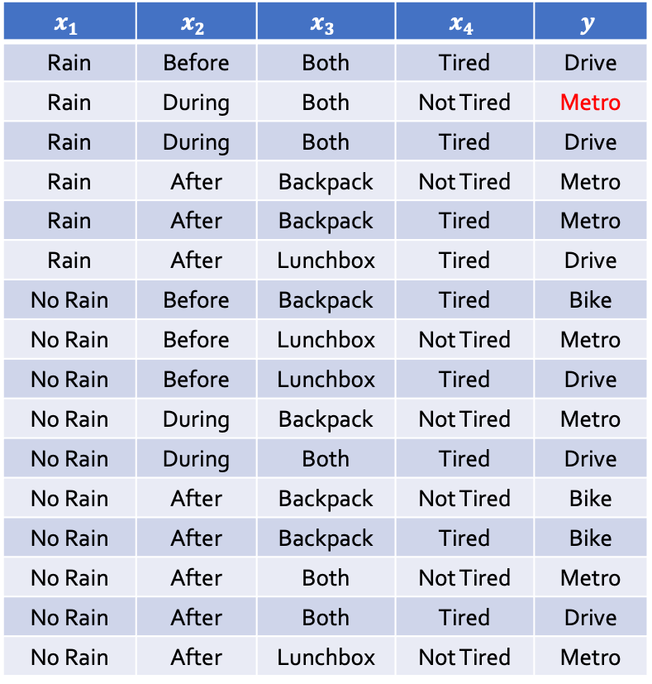
Illustration of ”High Variance” of Decision Trees
$$x_{1}$$ | $$x_{2}$$ | $$x_{3}$$ | $$x_{4}$$ | $$y$$
Rain | Before | Both | Tired | Drive
Rain | During | Both | Not Tired | Metro
Rain | During | Both | Tired | Drive
Rain | After | Backpack | Not Tired | Metro
Rain | After | Backpack | Tired | Metro
Rain | After | Lunchbox | Tired | Drive
No Rain | Before | Backpack | Tired | Bike
No Rain | Before | Lunchbox | Not Tired | Metro
No Rain | Before | Lunchbox | Tired | Drive
No Rain | During | Backpack | Not Tired | Metro
No Rain | During | Both | Tired | Drive
No Rain | After | Backpack | Not Tired | Bike
No Rain | After | Backpack | Tired | Bike
No Rain | After | Both | Not Tired | Metro
No Rain | After | Both | Tired | Drive
No Rain | After | Lunchbox | Not Tired | Metro
$$x_{1}$$ | $$x_{2}$$ | $$x_{3}$$ | $$x_{4}$$ | $$y$$
Rain | Before | Both | Tired | Drive
Rain | During | Both | Not Tired | Drive
Rain | During | Both | Tired | Drive
Rain | After | Backpack | Not Tired | Metro
Rain | After | Backpack | Tired | Metro
Rain | After | Lunchbox | Tired | Drive
No Rain | Before | Backpack | Tired | Bike
No Rain | Before | Lunchbox | Not Tired | Metro
No Rain | Before | Lunchbox | Tired | Drive
No Rain | During | Backpack | Not Tired | Metro
No Rain | During | Both | Tired | Drive
No Rain | After | Backpack | Not Tired | Bike
No Rain | After | Backpack | Tired | Bike
No Rain | After | Both | Not Tired | Metro
No Rain | After | Both | Tired | Drive
No Rain | After | Lunchbox | Not Tired | Metro
High variance: A small deviation of data would lead to very different learned hypothesis

Slide 12
Decision Tree Hypothesis
Pros
Easy to interpret (interpretability is getting attention and is important in some domains)
Can handle multi-type data (Numerical, categorical. …)
Easy to implement (Bunch of if-else rules)
Cons
Generally speaking, bad generalization
VC dimension is infinity
High variance (small change of data leads to very different hypothesis)
Easily overfit
Why we care?
One of the classical model
Building block for other models
Annual Income
$$≥100k$$
$$≥20k$$
$$<100k$$
$$<20k$$
Approve
have debt?
Deny
Deny
yes
no
Deny
Deny
Approve
Approve
Credit Card Approval Example

Slide 13
Today’s Lecture
The notes are not intended to be comprehensive. They should be accompanied by lectures and/or textbook.
Let me know if you spot errors.

Slide 14
Ensemble Learning

Slide 15
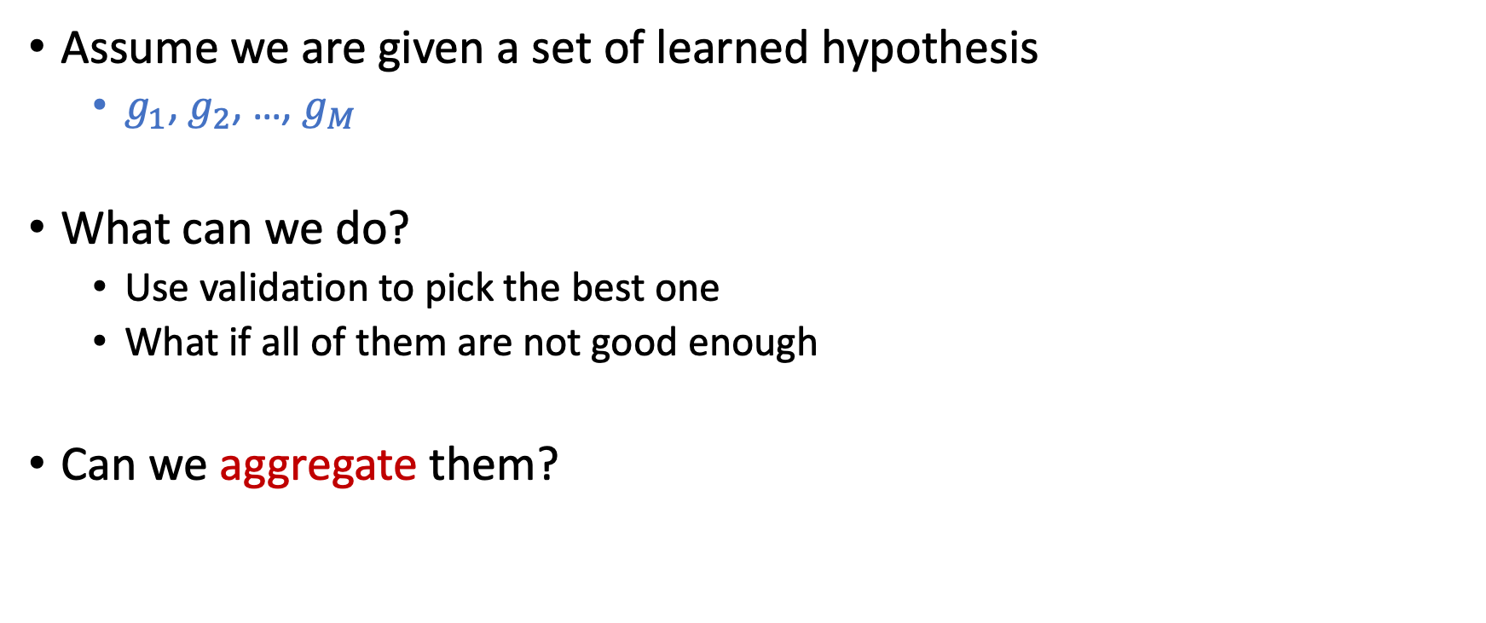
Ensemble Learning
Assume we are given a set of learned hypothesis
$g_{1}$, $g_{2}$, …, $g_{M}$
What can we do?
Use validation to pick the best one
What if all of them are not good enough
Can we aggregate them?

Slide 16
Is Aggregation a Good Idea?
At a 1906 country fair, ~800 people participate in a contest to guess the weight of an ox.
Reward is given to the person with the closest guess.
The average guess is 1,197lbs. The true answer is 1,198lbs.

Slide 17
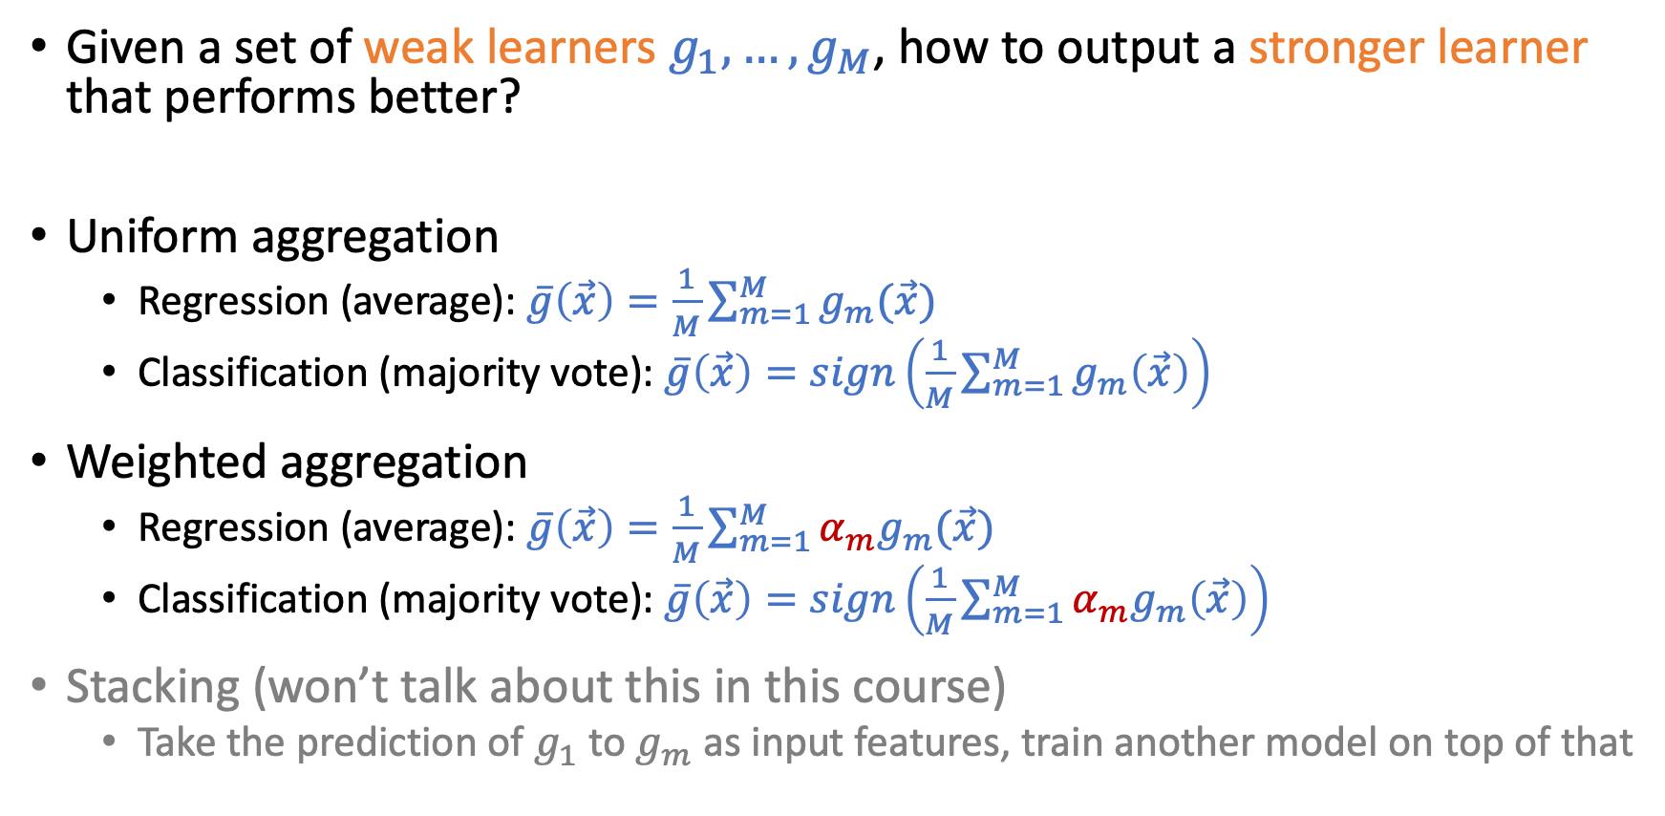
How to do Aggregation
Given a set of weak learners $g_{1},…,g_{M}$, how to output a stronger learner that performs better?
Uniform aggregation
Regression (average): $\overline{g}\left(\vec{x}\right)=\frac{1}{M}\sum_{m=1}^{M}{g_{m}(\vec{x})}$
Classification (majority vote): $\overline{g}\left(\vec{x}\right)=sign\left(\frac{1}{M}\sum_{m=1}^{M}{g_{m}\left(\vec{x}\right)}\right)$
Weighted aggregation
Regression (average): $\overline{g}\left(\vec{x}\right)=\frac{1}{M}\sum_{m=1}^{M}{{α_{m}g}_{m}(\vec{x})}$
Classification (majority vote): $\overline{g}\left(\vec{x}\right)=sign\left(\frac{1}{M}\sum_{m=1}^{M}{α_{m}g_{m}\left(\vec{x}\right)}\right)$
Stacking (won’t talk about this in this course)
Take the prediction of $g_{1}$ to $g_{m}$ as input features, train another model on top of that
Mathematically, majority voting and average is similar with +1/-1 labels

Slide 18
Is Aggregation a Good Idea?
Maybe
If the hypothesis is “diverse”, and “on average” they seem good
Question:
How do we find a set of hypothesis that are diverse and “on average” good
How do we aggregate the set of hypothesis
Ensemble learning
Bagging – Random Forest (This lecture)
Boosting – AdaBoost (Next lecture)

Slide 19
Is Aggregation a Good Idea?
Some illustrative examples

Slide 20
Is Aggregation a Good Idea?
Some illustrative examples

Slide 21
Is Aggregation a Good Idea?
Maybe
If the hypothesis is diverse, and “on average” they seem good
(If you take humans as weak learners, this is almost democracy)
Question:
How do we find a set of hypothesis that are diverse and “on average” good
How do we aggregate the set of hypothesis
Ensemble learning
Bagging – Random Forest (This lecture)
Boosting – AdaBoost (Next lecture)

Slide 22
Diverse Weak Learners
One common way to construct weak learners is via decision trees
Fully grown decision trees
High variance
Low bias
Decision stump (One-depth decision trees, split on only one attribute)
Low variance
High bias

Slide 23
Bagging
Bootstrapped Aggregating
(Using randomization to construct diverse weak learners)

Slide 24
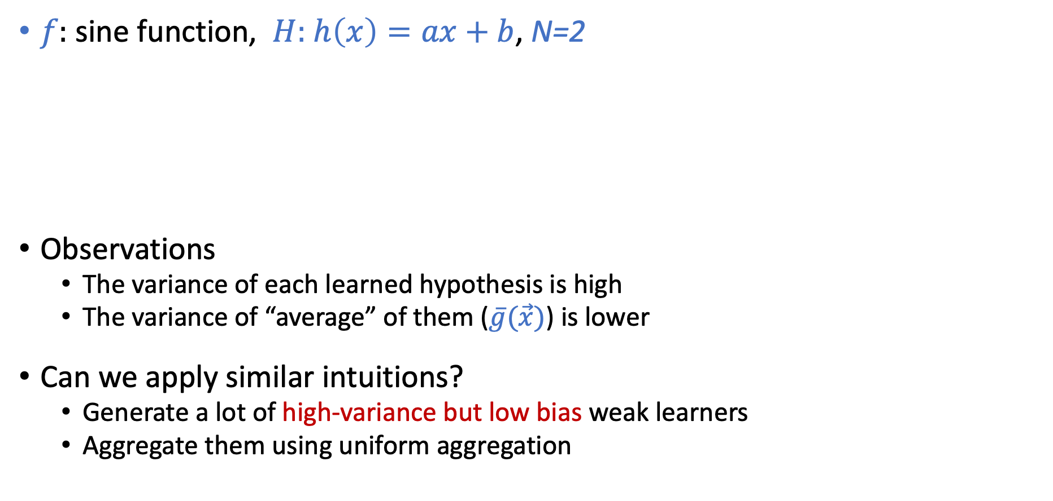
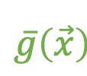
Review: Bias-Variance Decomposition
$f:$ sine function, $H:$ $h\left(x\right)=ax+b$, N=2
Observations
The variance of each learned hypothesis is high
The variance of “average” of them ($\overline{g}(\vec{x})$) is lower
Can we apply similar intuitions?
Generate a lot of high-variance but low bias weak learners
Aggregate them using uniform aggregation
Draw many datasets,
learn many hypothesis
$$\overline{g}\left(\vec{x}\right)$$
For each dataset, learn a hypothesis.
Take average.
We only have one dataset in practice!

Slide 25
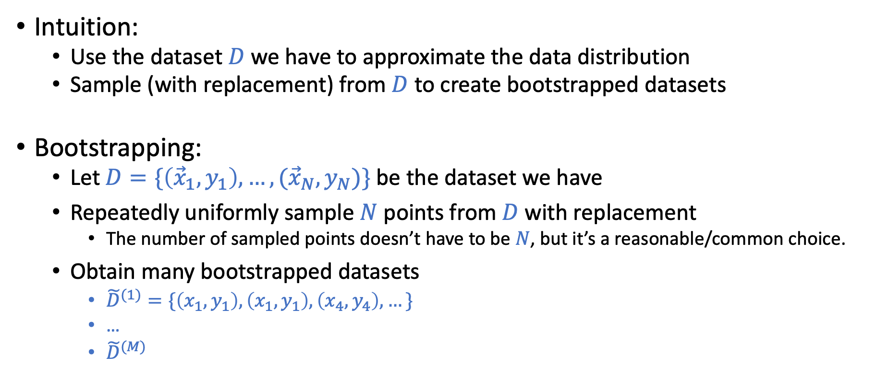
Bootstrapping
Intuition:
Use the dataset $D$we have to approximate the data distribution
Sample (with replacement) from $D$ to create bootstrapped datasets
Bootstrapping:
Let $D=\{\left({\vec{x}}_{1},y_{1}\right),…,({\vec{x}}_{N},y_{N})\}$ be the dataset we have
Repeatedly uniformly sample $N$ points from $D$ with replacement
The number of sampled points doesn’t have to be $N$, but it’s a reasonable/common choice.
Obtain many bootstrapped datasets
${\tilde{D}}^{(1)}=\{\left(x_{1},y_{1}\right), \left(x_{1},y_{1}\right),\left(x_{4},y_{4}\right),…\}$
…
${\tilde{D}}^{(M)}$

Slide 26
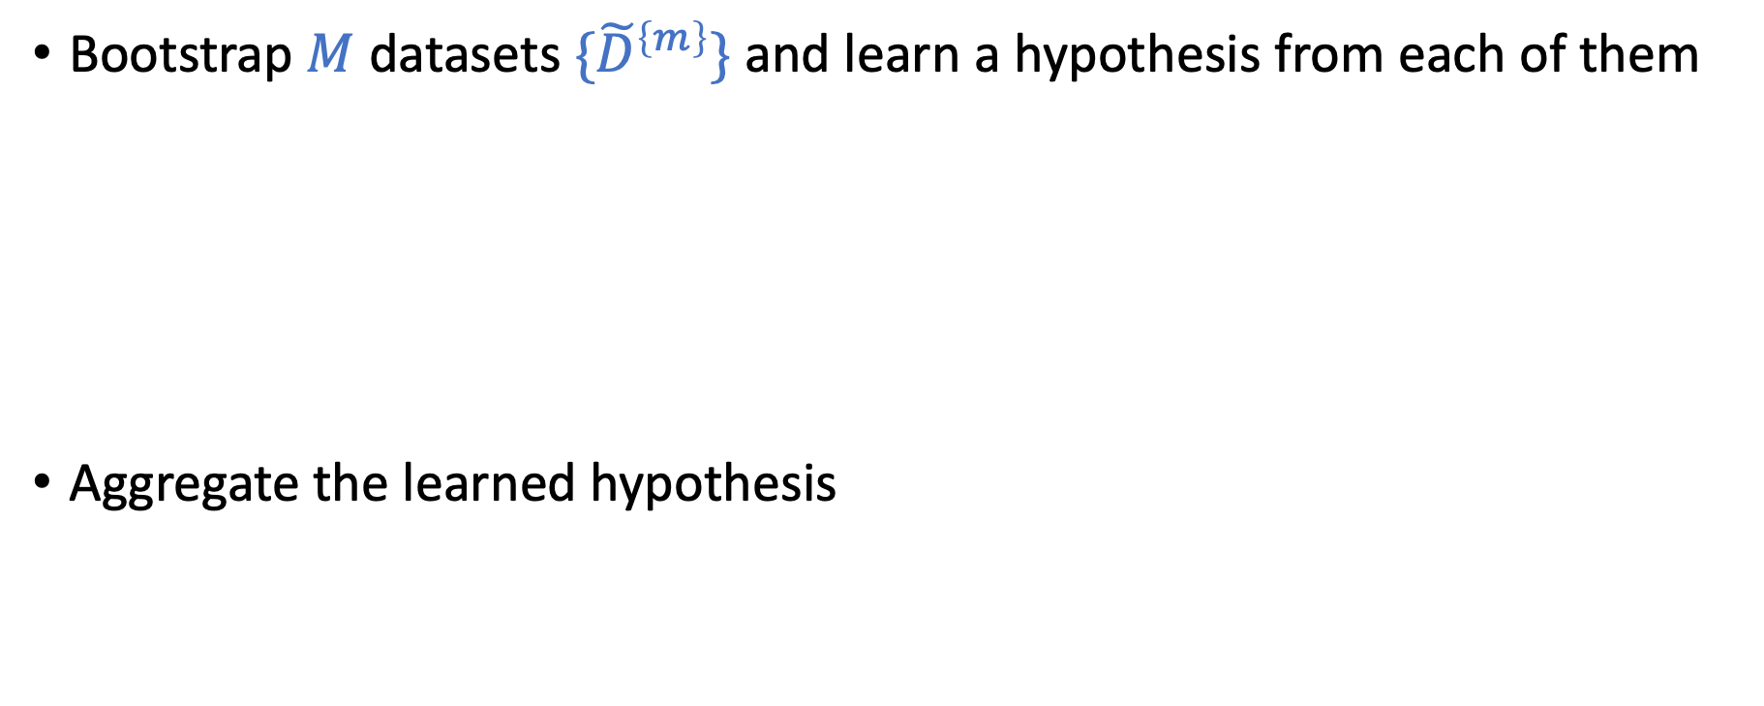
Bagging - Bootstrapped Aggregating
Bootstrap $M$ datasets ${\{\tilde{D}}^{\left\{m\right\}}\}$and learn a hypothesis from each of them
Aggregate the learned hypothesis

Slide 27
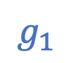
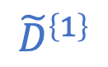


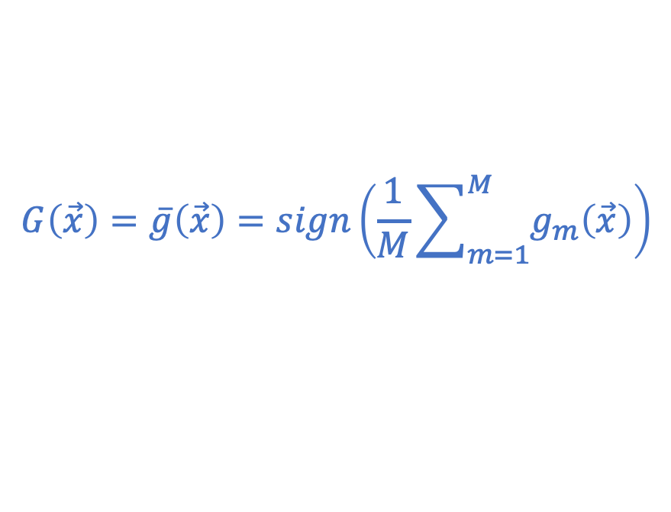
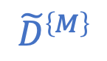
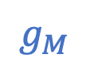
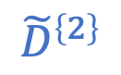
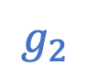
Bagging - Bootstrapped Aggregating
Bootstrap $M$ datasets ${\{\tilde{D}}^{\left\{m\right\}}\}$and learn a hypothesis from each of them
Aggregate the learned hypothesis
$${\tilde{D}}^{\left\{1\right\}}$$
$$g_{1}$$
$${\tilde{D}}^{\left\{2\right\}}$$
$$g_{2}$$
$$H$$
$$…$$
$${\tilde{D}}^{\left\{M\right\}}$$
$$g_{M}$$
$$G\left(\vec{x}\right)=\overline{g}\left(\vec{x}\right)=sign\left(\frac{1}{M}\sum_{m=1}^{M}{g_{m}\left(\vec{x}\right)}\right)$$
(assume we are doing classification)

Slide 28
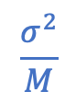
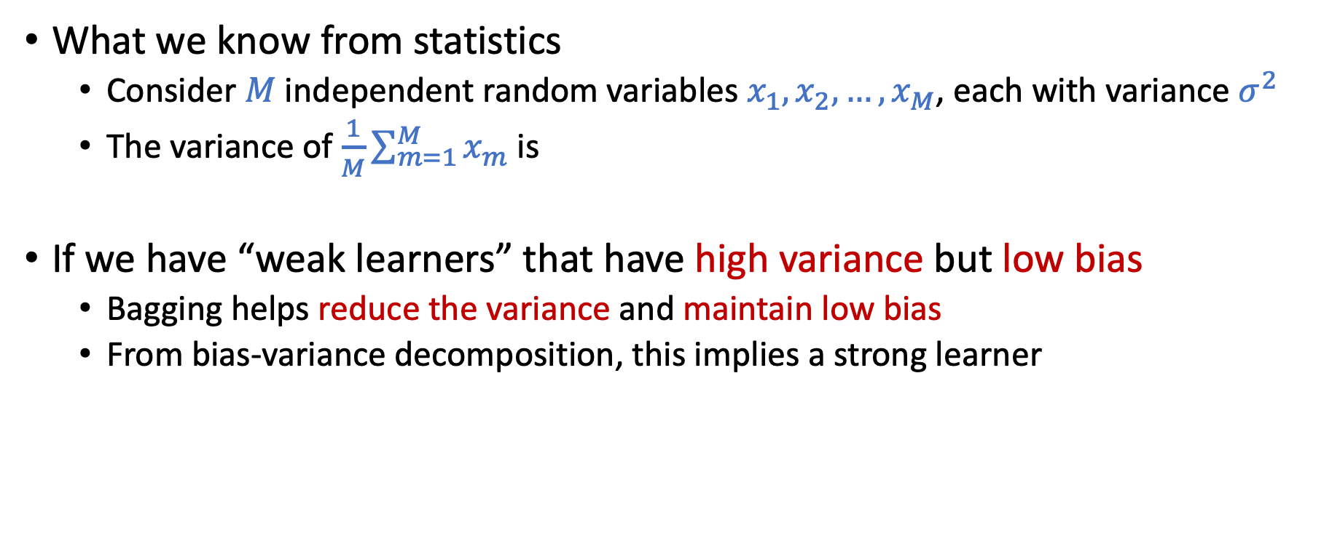
Why/When Bagging Might Be Helpful?
What we know from statistics
Consider $M$independent random variables $x_{1},x_{2},…,x_{M}$, each with variance $σ^{2}$
The variance of $\frac{1}{M}\sum_{m=1}^{M}{x_{m}}$ is
If we have “weak learners” that have high variance but low bias
Bagging helps reduce the variance and maintain low bias
From bias-variance decomposition, this implies a strong learner
$$\frac{σ^{2}}{M}$$

Slide 29
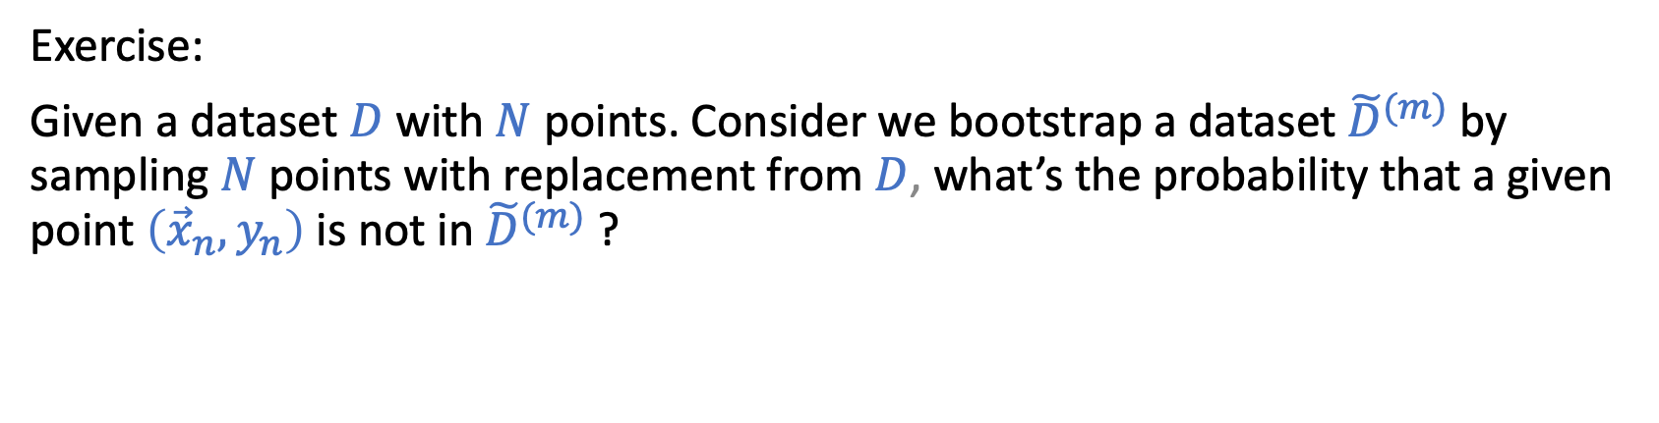
Break and Question
Exercise:
Given a dataset $D$ with $N$ points. Consider we bootstrap a dataset ${\tilde{D}}^{(m)}$ by sampling $N$ points with replacement from $D$, what’s the probability that a given point $\left({\vec{x}}_{n},y_{n}\right)$ is not in ${\tilde{D}}^{(m)}$ ?

Slide 30
Out-Of-Bag (OOB) Error

Slide 31
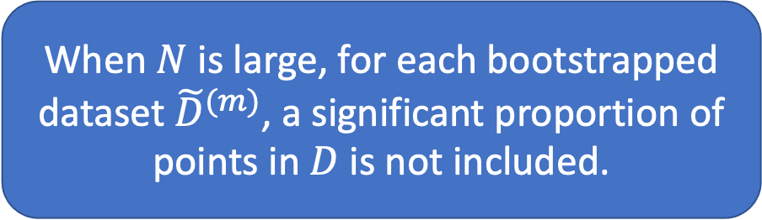
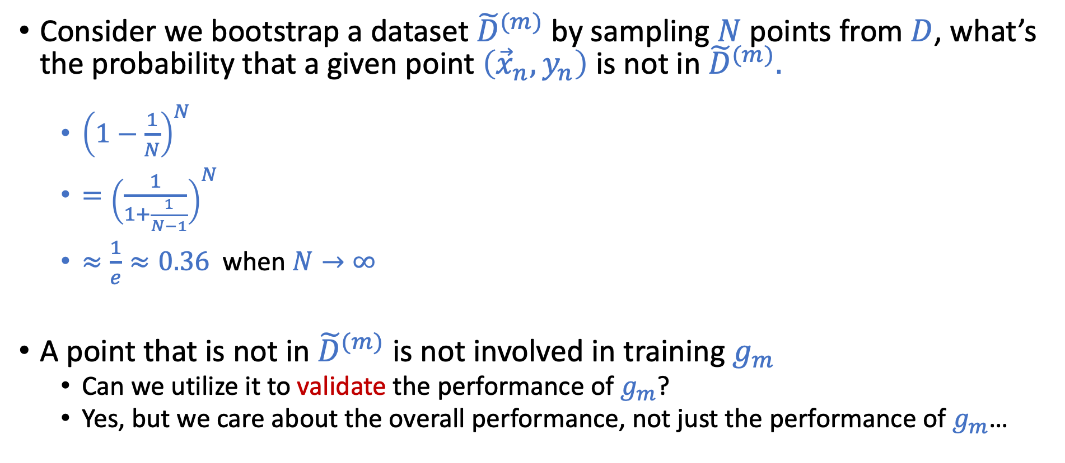
Probability for a Point to be Out of Bag
Consider we bootstrap a dataset ${\tilde{D}}^{(m)}$ by sampling $N$ points from $D$, what’s the probability that a given point $\left({\vec{x}}_{n},y_{n}\right)$ is not in ${\tilde{D}}^{(m)}.$
${\left(1−\frac{1}{N}\right)}^{N}$
$={\left(\frac{1}{1+\frac{1}{N−1}}\right)}^{N}$
$≈\frac{1}{e}≈0.36$ when $N→∞$
A point that is not in ${\tilde{D}}^{(m)}$ is not involved in training $g_{m}$
Can we utilize it to validate the performance of $g_{m}$?
Yes, but we care about the overall performance, not just the performance of $g_{m}$…
When $N$ is large, for each bootstrapped dataset ${\tilde{D}}^{(m)}$, a significant proportion of points in $D$is not included.

Slide 32
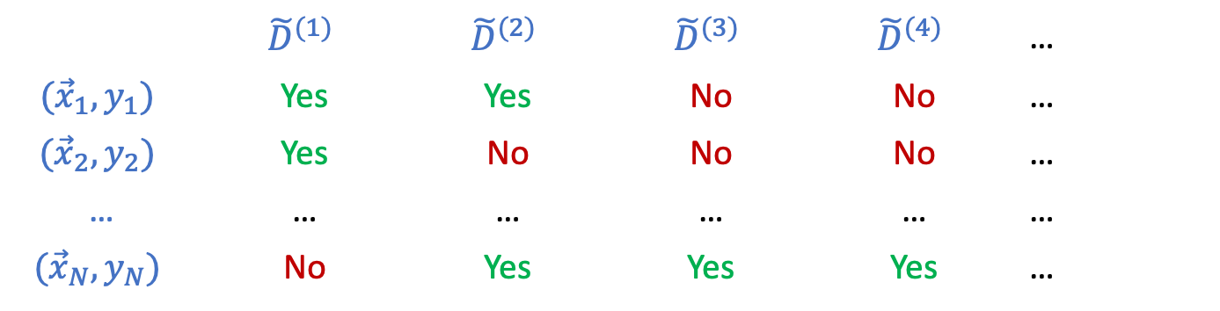
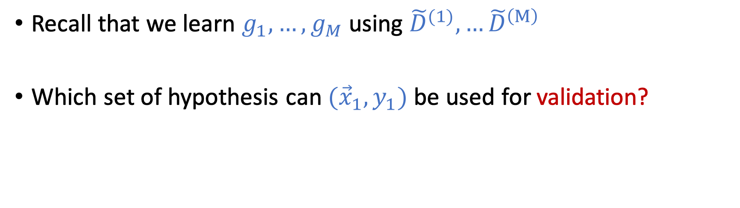
Out-Of-Bag (OOB) Error
 | $${\tilde{D}}^{(1)}$$ | $${\tilde{D}}^{(2)}$$ | $${\tilde{D}}^{(3)}$$ | $${\tilde{D}}^{(4)}$$ | …
$${(\vec{x}}_{1},y_{1})$$ | Yes | Yes | No | No | …
$${(\vec{x}}_{2},y_{2})$$ | Yes | No | No | No | …
… | … | … | … | … | …
$${(\vec{x}}_{N},y_{N})$$ | No | Yes | Yes | Yes | …
Whether a point is in a bootstrapped dataset
Recall that we learn $g_{1},…,g_{M}$ using ${\tilde{D}}^{(1)},…{\tilde{D}}^{\left(M\right)}$
Which set of hypothesis can ${(\vec{x}}_{1},y_{1})$ be used for validation?

Slide 33
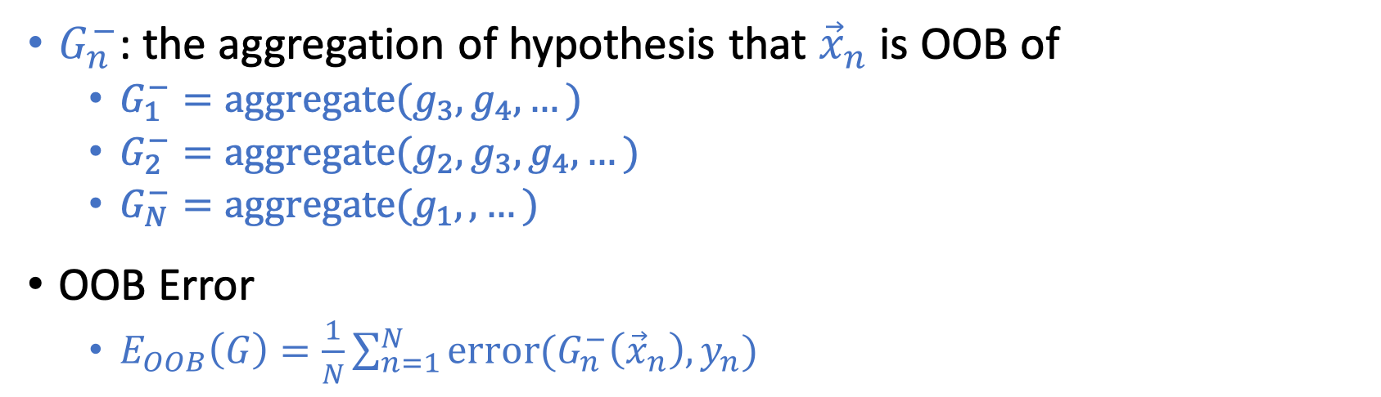
Out-Of-Bag (OOB) Error
 | $${\tilde{D}}^{(1)}$$ | $${\tilde{D}}^{(2)}$$ | $${\tilde{D}}^{(3)}$$ | $${\tilde{D}}^{(4)}$$ | …
$${(\vec{x}}_{1},y_{1})$$ | Yes | Yes | No | No | …
$${(\vec{x}}_{2},y_{2})$$ | Yes | No | No | No | …
… | … | … | … | … | …
$${(\vec{x}}_{N},y_{N})$$ | No | Yes | Yes | Yes | …
Whether a point is in a bootstrapped dataset
$G_{n}^{−}$: the aggregation of hypothesis that ${\vec{x}}_{n}$ is OOB of
$G_{1}^{−}=\text{aggregate}(g_{3},g_{4},…)$
$G_{2}^{−}=\text{aggregate}(g_{2},g_{3},g_{4},…)$
$G_{N}^{−}=\text{aggregate}(g_{1},,…)$
OOB Error
$E_{OOB}\left(G\right)=\frac{1}{N}\sum_{n=1}^{N}{\text{error}(G_{n}^{−}\left({\vec{x}}_{n}\right),y_{n})}$
Aggregate:
Majority voting for classification
Average for regression
Error:
Binary error for classification
Squared error for regression

Slide 34
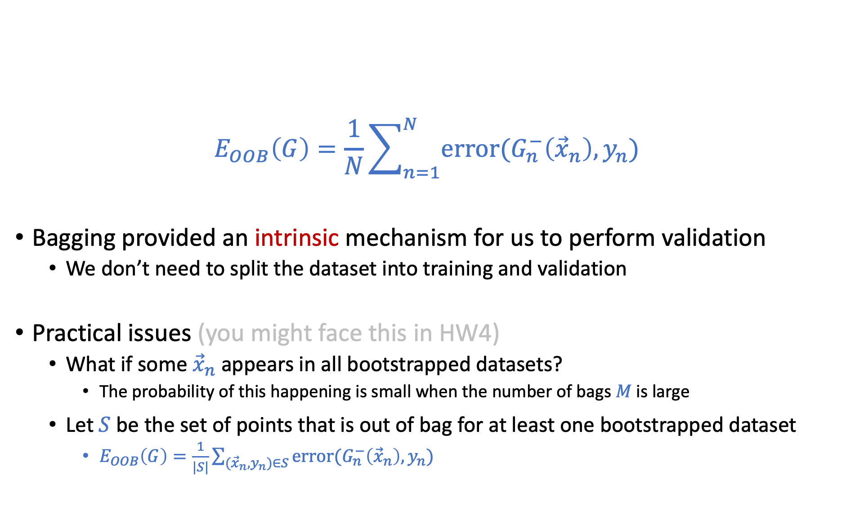
Out-Of-Bag (OOB) Error
$$E_{OOB}\left(G\right)=\frac{1}{N}\sum_{n=1}^{N}{\text{error}(G_{n}^{−}\left({\vec{x}}_{n}\right),y_{n})}$$
Bagging provided an intrinsic mechanism for us to perform validation
We don’t need to split the dataset into training and validation
Practical issues (you might face this in HW4)
What if some ${\vec{x}}_{n}$ appears in all bootstrapped datasets?
The probability of this happening is small when the number of bags $M$ is large
Let $S$ be the set of points that is out of bag for at least one bootstrapped dataset
$E_{OOB}\left(G\right)=\frac{1}{|S|}\sum_{({\vec{x}}_{n},y_{n})∈S}{\text{error}(G_{n}^{−}\left({\vec{x}}_{n}\right),y_{n})}$

Slide 35
Random Forest

Slide 36
What We Have Learned
Bagging:
A method to generate and aggregate many high-variance weak learners into a stronger one.
Decision tree:
Various nice properties
Bad generalization
- Due to high variance
Random Forest:
Construct many random trees
Aggregate the random trees

Slide 37
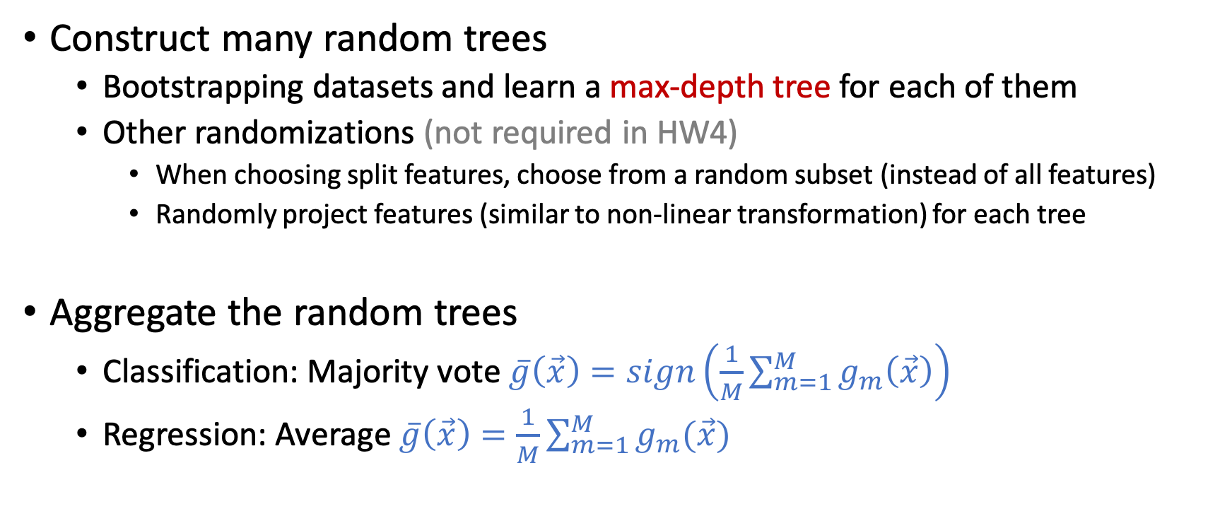
Random Forest
Construct many random trees
Bootstrapping datasets and learn a max-depth tree for each of them
Other randomizations (not required in HW4)
When choosing split features, choose from a random subset (instead of all features)
Randomly project features (similar to non-linear transformation) for each tree
Aggregate the random trees
Classification: Majority vote $\overline{g}\left(\vec{x}\right)=sign\left(\frac{1}{M}\sum_{m=1}^{M}{g_{m}\left(\vec{x}\right)}\right)$
Regression: Average $\overline{g}\left(\vec{x}\right)=\frac{1}{M}\sum_{m=1}^{M}{g_{m}(\vec{x})}$

Slide 38
Questions?
Note that in HW4, you will be asked to implement Bagging Decision Tree and calculate the OOB errors.
Make sure you know the definitions/algorithm well.

Slide 39
Brief Discussion on Feature Importance
Not all features are equally important
Some features could be redundant -- (birth year, age)
Some features might be irrelevant -- feature: name, label: prob of heart attack
How do we know which features are more important?
Linear models:
The size of the weight is a proxy for feature importance
Applying L1 regularization is one way to reduce the number of features
Decision tree:
The feature closer to the root is probably more important
Random forest:
Average “information gain” of all trees is a proxy for feature importance
See LFD e-Chap 9.2 for more discussion on feature selection

Slide 40
Boosting

Slide 41
Ensemble Learning
Goal: Utilize a set of weak learners to obtain a strong learner.
Format of ensemble learning
Construct many diverse weak learners
Aggregate the weak learners
Bagging:
Construct diverse weak learners
(Simultaneously) bootstrapping datasets
Train weak learners on them
Aggregate the weak learners
Uniform aggregation
Boosting
Construct diverse weak learners
Adaptively generating datasets
Train weak learners on them
Aggregate the weak learners
Weighted aggregation

Slide 42
Informal Intuitions about Boosting
Example : Teach a class of kids to identify apples from data
Alice: Apples are circular
Teacher: Circular is a good feature, but using this feature might make some mistakes
Let me highlight the mistakes.
Make correct images smaller
Make incorrect images larger
Apples
Not
Apples
Example created by Hsuan-Tien Lin

Slide 43
Informal Intuitions about Boosting
Example : Teach a class of kids to identify apples from data
Alice: Apples are circular
Bob: Apples are red
Teacher: Yes, many apples are red but it could still make mistakes. Let me highlight the mistakes.
Make correct images smaller
Make incorrect images larger
Example created by Hsuan-Tien Lin

Slide 44
Informal Intuitions about Boosting
Example : Teach a class of kids to identify apples from data
Alice: Apples are circular
Bob: Apples are red
Charlie: Apples could be green
Example created by Hsuan-Tien Lin

Slide 45
Informal Intuitions about Boosting
Example : Teach a class of kids to identify apples from data
Alice: Apples are circular
Bob: Apples are red
Charlie: Apples could be green
David: Apples have stems at the top
Class: Apples are somewhat circular, somewhat red, possibly green, and may have stems at the top
Example created by Hsuan-Tien Lin

Slide 46
Informal Intuitions about Boosting
Example : Teach a class of kids to identify apples from data
Alice: Apples are circular
Bob: Apples are red
Charlie: Apples could be green
David: Apples have stems at the top
Class: Apples are somewhat circular, somewhat red, possibly green, and may have stems at the top
Key steps of this process:
Learn a simple hypothesis for each dataset
Iteratively update the dataset to focus on what we got wrong (i.e., create diversity)
Aggregate the learned simple hypothesis
Example created by Hsuan-Tien Lin

Slide 47
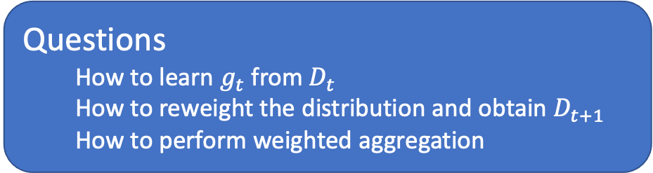
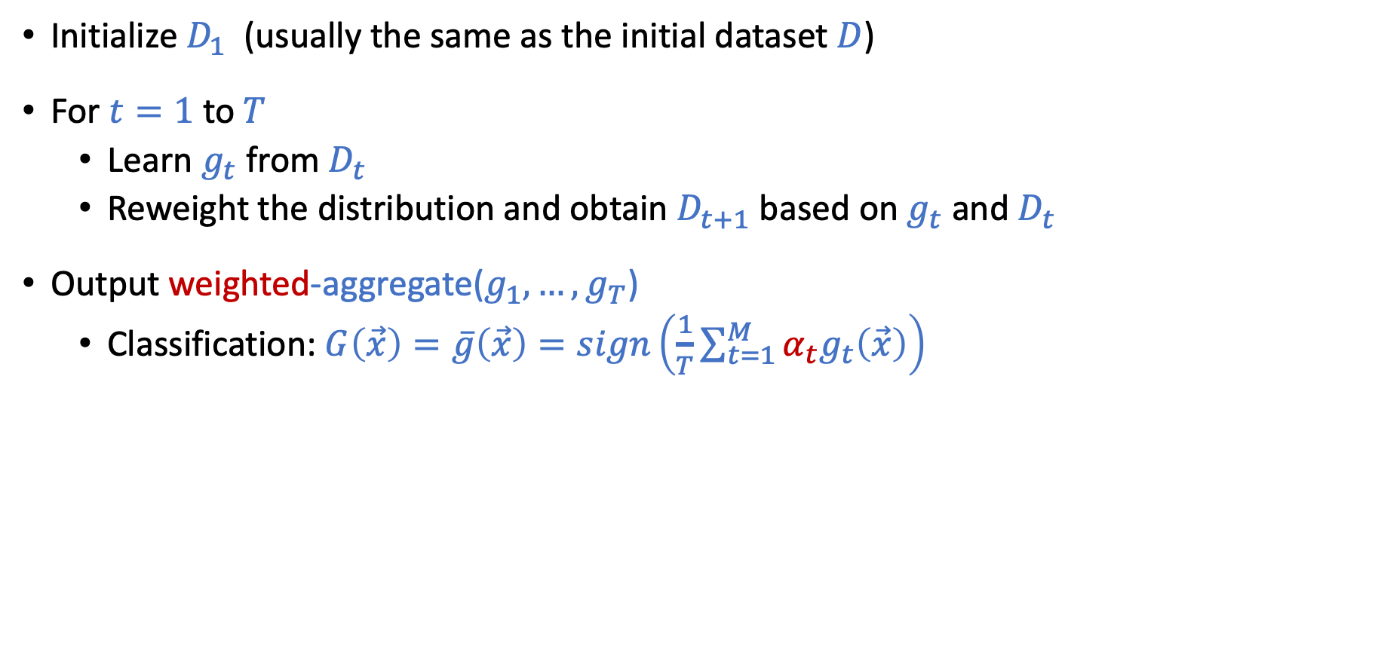
Outline of a Boosting Algorithm
Initialize $D_{1}$ (usually the same as the initial dataset $D$)
For $t=1$ to$T$
Learn $g_{t}$ from $D_{t}$
Reweight the distribution and obtain $D_{t+1}$ based on $g_{t}$ and $D_{t}$
Output weighted-aggregate($g_{1},…,g_{T}$)
Classification: $G\left(\vec{x}\right)=\overline{g}\left(\vec{x}\right)=sign\left(\frac{1}{T}\sum_{t=1}^{M}{α_{t}g_{t}\left(\vec{x}\right)}\right)$
Questions
How to learn $g_{t}$ from $D_{t}$
How to reweight the distribution and obtain $D_{t+1}$
How to perform weighted aggregation

Slide 48



Discussion on Re-weighted $D_{t}$ (What does re-weighting mean?)
Original Dataset $D=\{\left({\vec{x}}_{1},y_{1}\right),…,\left({\vec{x}}_{N}, y_{N}\right)\}$
Notation of $D_{t}$
$D_{t}\left(n\right)$ is the weight/probability of data point $\left({\vec{x}}_{n},y_{n}\right)$ in $D_{t}$
$\sum_{n=1}^{N}{D_{t}\left(n\right)=1}$
What is $E_{in}(h)$ on $D_{t}$? (Expressed as $E_{in}^{\left(D_{t}\right)}(h)$)
Re-sample dataset (noisier)
Re-sample the dataset from $D$ according to distribution $D_{t}$
Calculate $E_{in}$ on the re-sampled dataset as usual
Calculate weighted error
$E_{in}^{\left(D_{t}\right)}(h)=\sum_{n=1}^{N}{D_{t}\left(n\right) \text{error}(h\left({\vec{x}}_{n}\right),y_{n})}$
When $D_{t}\left(n\right)=1/N.$ This reduces to standard definition of $E_{in}$.

